Slide 1
AI and human rights
Adjunct Professor Katrin Nyman Metcalf
Tallinn 6 November 2025

Slide 2
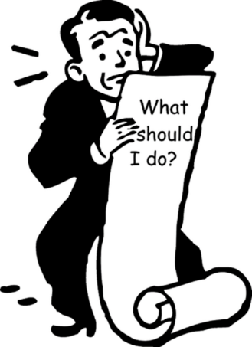
Does AI change the world?
Can we understand the challenges?
Can we trust the technology?
Can we regulate away the risks?
People who have developed AI urge restraint (regulation) – different from earlier technology-sceptical movements
‘Black box’ of algorithms

Slide 3
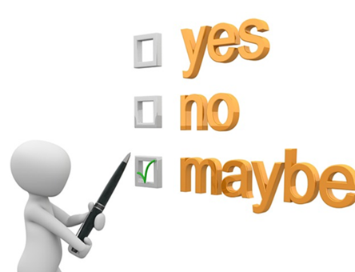
Should AI be used? (Do we need to automate just because we can?)
Are automated decisions suitable?
Does human involvement serve a purpose?
Can the technology be stopped?
How and by whom?

Slide 4
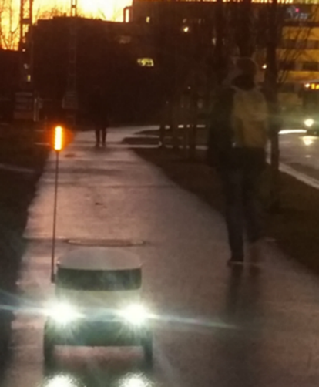
AI in society: legal implications
Risk of manipulation of humans, unintended consequences, automated illegal actions
Risk of discrimination
Risks for fundamental legal principles
Due process
Access to information
Data protection (how AI uses information)
Reasons provided for administrative decisions

Slide 5
AI legal instruments
Legislation – EU AI Act (Regulation (EU) 2024/1689, 1 August 2024); national law (e.g. Canada)
Council of Europe Framework Convention on AI, Human Rights, Democracy and the Rule of Law (May 2024)
Self-regulation by companies (AI regulation by voluntary commitments by companies 2022)
Specific laws (e.g. US – Consumer protection law)
Technical standards
Codes of practice, ethical rules and guidelines (multistakeholderism)
Media literacy, including recognising disinformation

Slide 6
EU AI ACT – Categories of Risk
Unacceptable risk
Cognitive behavioural manipulation (vulnerable groups)
Social scoring
Real-time, remote biometric identification (facial recognition) - exceptions “post”, prosecute serious crimes, court approval
High risk
Negatively affect safety, human rights
1) EU product safety law
2) Specific areas, registration demand (critical infrastructure, law enforcement, migration, etc)
Generative AI (ChatGPT)
Transparency requirements: Disclosing content generated by AI
Design to prevent generating illegal content
Limited risk
Comply with minimal transparency requirements, allow user informed decisions.
After interacting the user can decide whether to continue
Users made aware when they are interacting with AI (including systems that generate/manipulate image, audio or video content, e.g. deepfakes)

Slide 7

Future of AI law?
Is speculation about extreme risks undermining discussions on more imminent risks? (Risk of AI building biological weapons vs. risk of AI interfering in democratic processes)?
Can specific types of AI be limited (licenses, bans on certain types, etc.)? How can this be enforced?
Is a risk-based approach sufficient also in the future?

Slide 8
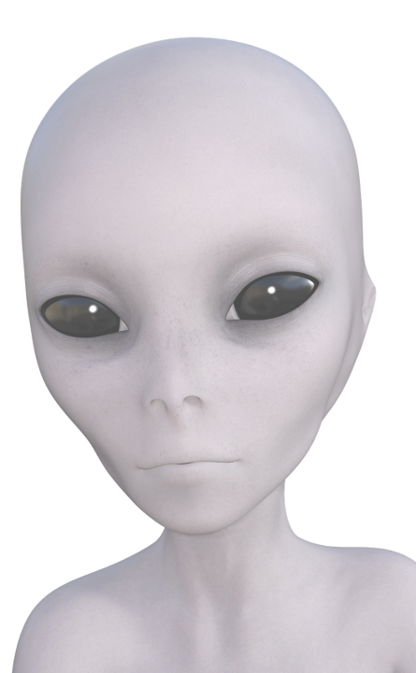
DOES AI HAVE (HUMAN) RIGHTS? LEGAL PERSONALITY FOR AI
Legal personality to non-humans:
“Province of all mankind” (outer space, deep seabed)
Animals seen as objects and not subjects
River in New Zealand
Should AI have legal personality?
Is it possible, and how, to make legal personality of non-humans actually have legal effect (mean something)?

Slide 9
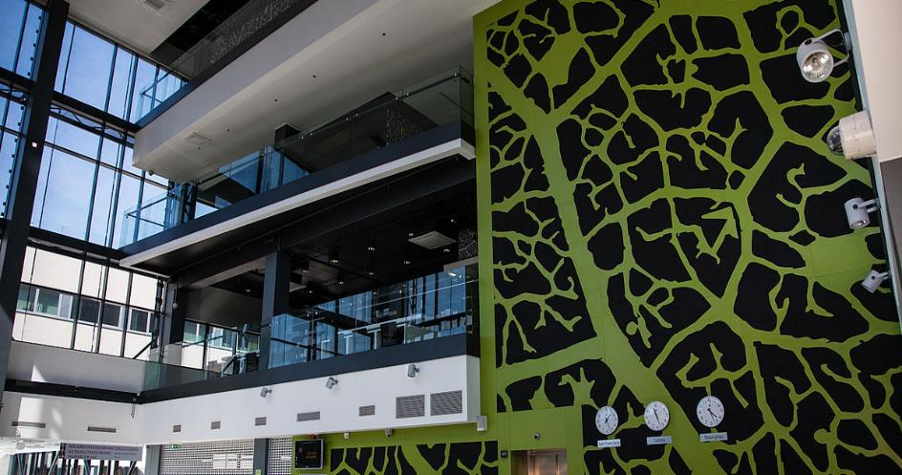
Thank you!

